Slide 1
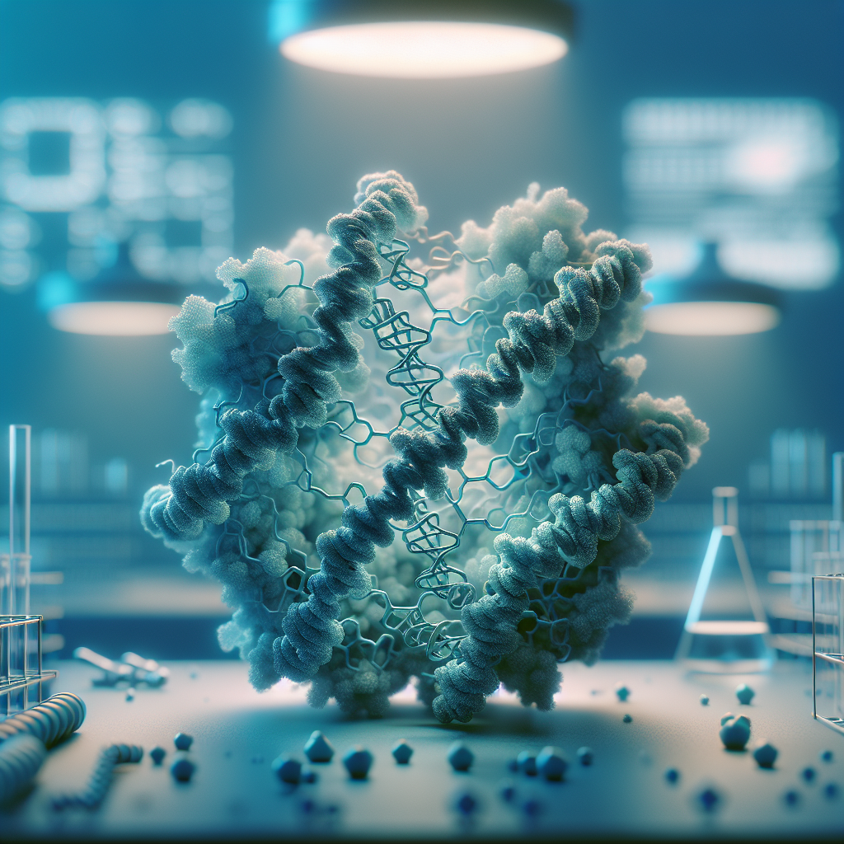
CRISPR: From Discovery to Clinic
A concise tour from bacterial immunity to first‑in‑class human therapies—science, delivery, safety, ethics, and markets.

